Slide 1
Strengthening the Role of Women with Disabilities
In Humanitarian Action
© Women’s Refugee Commission
Notes:
These slides covers Session 2 of the Facilitator’s Guide: Strengthening the Role of Women with Disabilities in Humanitarian Action. (ADD LINK)
February 2017

Slide 2
What is a Humanitarian Crisis?
A humanitarian emergency is an event or series of events that represents a critical threat to the health, safety, security or wellbeing of a community or other large group of people, usually over a wide area.
- Humanitarian Coalition
Activity 2.1. Definition and types of humanitarian crisis
Notes:
Activity 2.1. Definition and types of humanitarian crisis- Slide 1/6

Slide 3
What are different types of crises?
Natural disasters
Man-made disasters
Complex emergencies
Activity 2.1. Definition and types of humanitarian crisis
Notes:
Activity 2.1. Definition and types of humanitarian crisis- Slide 2/6

Slide 4
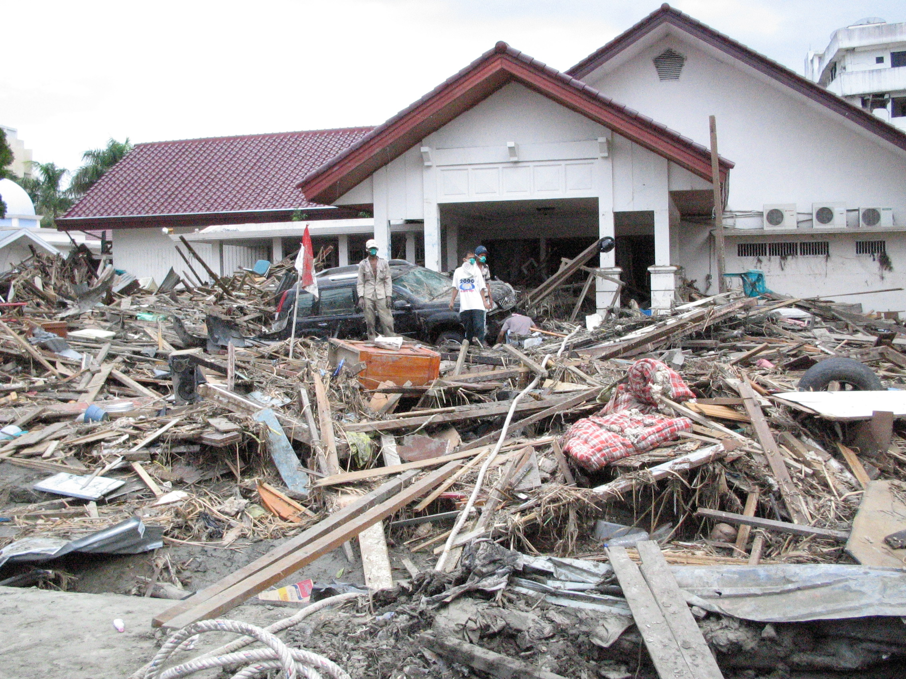
Natural Disasters
Can be geophysical (e.g., earthquakes, tsunamis and volcanic eruptions), hydrological (e.g., floods, avalanches), climatological (e.g. droughts), meteorological (e.g., storms, cyclones), or biological (e.g., epidemics, plagues)
Example: The 2004 Indian Ocean Earthquake
triggered a series of tsunamis off the coasts
of 11 countries with Indonesia, Sri Lanka, India, and Thailand the hardest hit. An estimated 230,000-280,000 people were killed as a result. and it’s considered the deadliest natural disaster in recorded history.
Flicker: @AusAid
Notes:
Activity 2.1. Definition and types of humanitarian crisis- Slide 3/6

Slide 5
Man-made disasters
Including such things as armed conflicts, plane and train crashes, fires and industrial accidents.
Example: The BP oil spill of 2010,
which resulted from a gas explosion
on a oil rig off the coast of Louisiana,
impacted 180,000 km² of ocean and
had a devastating effect on marine life
in the Gulf of Mexico.
Flicker: Petty Officer 3rd Class Patrick Kelley
Activity 2.1. Definition and types of humanitarian crisis
Notes:
Activity 2.1. Definition and types of humanitarian crisis- Slide 4/6

Slide 6
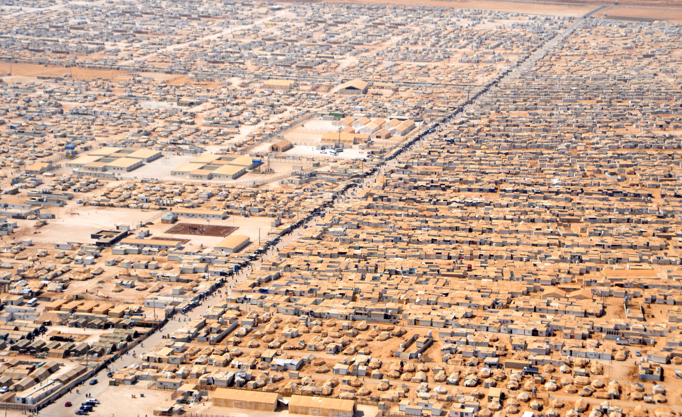
Complex Emergencies
“A humanitarian crisis in a country, region, or society where there is total or considerable breakdown of authority resulting from internal or external conflict and which requires an international response that goes beyond the mandate or capacity of any single agency and/ or the ongoing United Nations country program.” (IASC, December 1994).
Example: The Syrian civil war has led to mass displacement internally, and into neighboring Turkey, Lebanon, Jordan, Iraq, and Egypt. There has been ongoing bombardment and insecurity in large parts of the country over a six-year period, with access to essential humanitarian assistance and services restricted for parts of Syria including food and emergency medical treatment.
Notes:
Activity 2.1. Definition and types of humanitarian crisis- Slide 5/6
Photocredit: https://www.flickr.com/photos/acnurlasamericas

Slide 7
The Humanitarian Imperative comes first…
The primary motivation is to prevent or alleviate human suffering arising out of disaster or conflict. (Red Cross NGO Code of Conduct, SPHERE Project)
Humanitarian agencies must maintain their ability to obtain and sustain access to all vulnerable populations, and to negotiate such access with all parties to the conflict.
Activity 2.2. Humanitarian objectives & principles
Notes:
Activity 2.2. Humanitarian objectives & principles – Slide 1/6

Slide 8
Key Humanitarian Principles*
Humanity
Impartiality
Independence
Neutrality
*CHS Alliance (2014). Core Humanitarian Standard on Quality and Accountability, p. 8. Retrieved from https://corehumanitarianstandard.org/files/files/Core%20Humanitarian%20Standard%20-%20English.pdf
Notes:
Activity 2.2. Humanitarian objectives & principles – Slide 2/6

Slide 9
Key Humanitarian Principle 1
Humanity: Human suffering must be addressed wherever it is found. The purpose of humanitarian action is to protect life and ensure respect for human beings.
Activity 2.2. Humanitarian objectives & principles
Notes:
Activity 2.2. Humanitarian objectives & principles – Slide 3/6

Slide 10
Key Humanitarian Principle 2
Impartiality: Humanitarian action must be carried out on the basis of need alone, giving priority to the most urgent cases of distress and making no adverse distinction on the basis of nationality, race, gender, disability, religious belief, class, or political opinion.
Activity 2.2. Humanitarian objectives & principles
Notes:
Activity 2.2. Humanitarian objectives & principles – Slide 4/6

Slide 11
Key Humanitarian Principle 3
Independence: Humanitarian action must be autonomous from the political, economic, military or other objectives that any actor may hold with regard to areas where humanitarian action is being implemented.
Notes:
Activity 2.2. Humanitarian objectives & principles – Slide 5/6

Slide 12
Key Humanitarian Principle 4
Neutrality: Humanitarian assistance should be provided without engaging in hostilities or taking sides in controversies of a political, religious, or ideological nature.
Activity 2.2. Humanitarian objectives & principles
Notes:
Activity 2.2. Humanitarian objectives & principles – Slide 6/6

Slide 13
What is protection mainstreaming?
What Is Protection?
“All activities aimed at obtaining full respect for the rights of the individual in accordance with the letter and the spirit of the relevant bodies of law (i.e., human rights law, international humanitarian law, refugee law).” (IASC)
“The process through which fundamental human rights principles, including non-discrimination, meaningful access, safety, and dignity are recognized and realized in program design and implementation.” (IRC)
Activity 2.3 Protection mainstreaming
Notes:
Activity 2.3 Protection mainstreaming – Slide 1/5

Slide 14
Prioritizing the Safety and Dignity of Affected Populations
Safety of affected populations should always be the first concern in humanitarian action. But being safe is not enough if people do not have their dignity. People need to feel valued and to have a sense of self-respect. Prioritizing safety and dignity also entails reducing risk and ensuring that humanitarian action ‘does no harm.’
Activity 2.3 Protection mainstreaming
Notes:
Activity 2.3 Protection mainstreaming – Slide 2/5

Slide 15
Non-Discrimination and Meaningful Access to Assistance and Services
Programs should ensure that all people have a meaningful opportunity to attain their rights by accessing available services and assistance.
Conflict and divisions within society often emerge from discrimination resulting in one group being unable to access services.
Vulnerable individuals may face more challenges in accessing services or face discrimination within the community in which they live. Barriers to access exist in many different forms including logistical, social/cultural, insecurity, and lack of information on services available.
Activity 2.3 Protection mainstreaming
Notes:
Activity 2.3 Protection mainstreaming – Slide 3/5

Slide 16
Accountability
The process of using power responsibly, taking account of, and being held accountable by, different stakeholders, and primarily those who are affected by the exercise of such power.
Activity 2.3 Protection mainstreaming
Notes:
Activity 2.3 Protection mainstreaming – Slide 4/5

Slide 17
Participation and Empowerment
Ensuring that beneficiaries of programs are actively involved or even take full control of the humanitarian intervention. As well as receiving information, people have the right to participate in decisions that affect them. Special attention must be paid to ensure the participation and consultation with the most marginalized members of society who are often excluded from decision-making processes.
Activity 2.3 Protection mainstreaming
Notes:
Activity 2.3 Protection mainstreaming – Slide 5/5

Slide 18
What is the difference between refugees and IDPs?
Refugees are defined as a person who has been forced to flee his or her country because of persecution, war, or violence. A refugee has a well-founded fear of persecution for reasons of race, religion, nationality, political opinion, or membership in a particular social group. Most likely, they cannot return home or are afraid to do so. War and ethnic, tribal and religious violence are leading causes of refugees fleeing their countries.
IDPs are defined as a person who has been forced to flee his or her home for the same reason as a refugee, but remains in his or her own country and has not crossed an international border.*
*UNHCR (accessed 1/19/17). What is a refugee? From http://www.unrefugees.org/what-is-a-refugee/
Notes:
Activity 2.4 Mapping humanitarian stakeholders- Slide 1/2

Slide 19
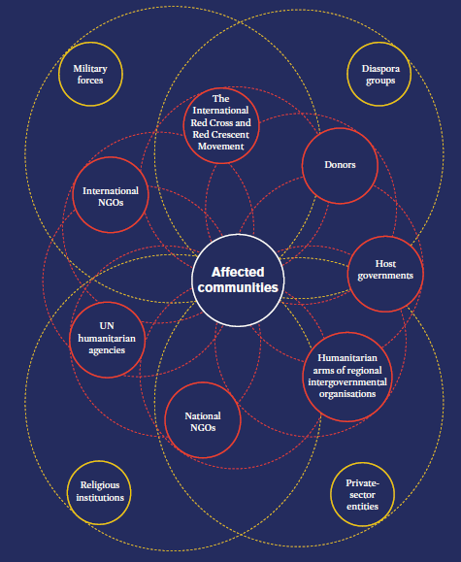
Mapping the Stakeholders
Source: ALNAP

Slide 20
Elements of the Humanitarian Program Cycle (HPC)
Notes:
Activity 2.5. Mapping the humanitarian program cycle – Slide 1/7

Slide 21
Coordination
In a humanitarian context, coordination involves bringing together humanitarian actors to ensure a coherent and principled response to emergencies. The aim is to assist people when they most need relief or protection. Effective coordination underpins all elements of the HPC.
Activity 2.5. Mapping the humanitarian program cycle
Notes:
Activity 2.5. Mapping the humanitarian program cycle – Slide 2/7

Slide 22
Needs Assessment
Needs assessments provide the data for humanitarian response planning, including the numbers of the target population, the staffing, and funding requirements. Assessments are coordinated, carried out jointly, and shared with all humanitarian stakeholders working in the particular region or country.
Activity 2.5. Mapping the humanitarian program cycle
Notes:
Activity 2.5. Mapping the humanitarian program cycle – Slide 3/7

Slide 23
Analysis
Analysis of the needs, vulnerabilities, and capacities of affected people is also undertaken. This analysis is based on existing information and on needs assessments, as referenced above. UN agencies, humanitarian organizations, national authorities, and community representatives participate in the data collection, and then identify and agree on the immediate needs and issues. Every organization involved in the response applies these findings to their programming.
Activity 2.5. Mapping the humanitarian program cycle
Notes:
Activity 2.5. Mapping the humanitarian program cycle – Slide 4/7

Slide 24
Response Planning
Response planning is based on the findings of needs assessments and analysis. Strategic objectives and priority activities are developed, including partners involved in implementation and funding requirements. The planning process should be done in consultation with government, development actors, civil society, and affected people. A response plan is disseminated broadly among humanitarian responders to guide programming, project planning and resourcing.
Every humanitarian emergency will have a response plan developed on a yearly or multi-year basis; some cover several regions such as the Refugee and Resilience Plan for the Region responding to the Syrian Crisis.
Activity 2.5. Mapping the humanitarian program cycle
Notes:
Activity 2.5. Mapping the humanitarian program cycle – Slide 5/7

Slide 25
Resource Mobilization
Entails fundraising for the humanitarian response, as outlined in the humanitarian response plan. A “flash appeal’ may be issued, which provides an overview of urgent life-saving needs. Pooled funding mechanisms (including any country-based pooled funds) are developed to fund in line with top priorities set in the humanitarian response plans. Pooled funds are multi-donor humanitarian financing mechanisms which are managed by OCHA at the country-level under the leadership of the Humanitarian Coordinator. Donor contributions to each country-based pooled fund are un-earmarked and allocated by the Humanitarian Coordinator through an in-country consultative process
Activity 2.5. Mapping the humanitarian program cycle
Notes:
Activity 2.5. Mapping the humanitarian program cycle – Slide 6/7

Slide 26
Implementation & Monitoring & Evaluation
Is a continuous process to ensure that humanitarian actors are provided the evidence they need to take decisions and adapt short and long-term strategies; and to ensure that organizations involved in the response remain accountable to affected people, national authorities, donors, and the general public.
Activity 2.5. Mapping the humanitarian program cycle
Notes:
Activity 2.5. Mapping the humanitarian program cycle – Slide 7/7

Slide 27
Research. Rethink. Resolve.
womensrefugeecommission.org
For more information, please contact:
Boram Lee, Disability Program Officer
boraml@wrcommission.org

